Slide 1
FIGURER

Slide 2
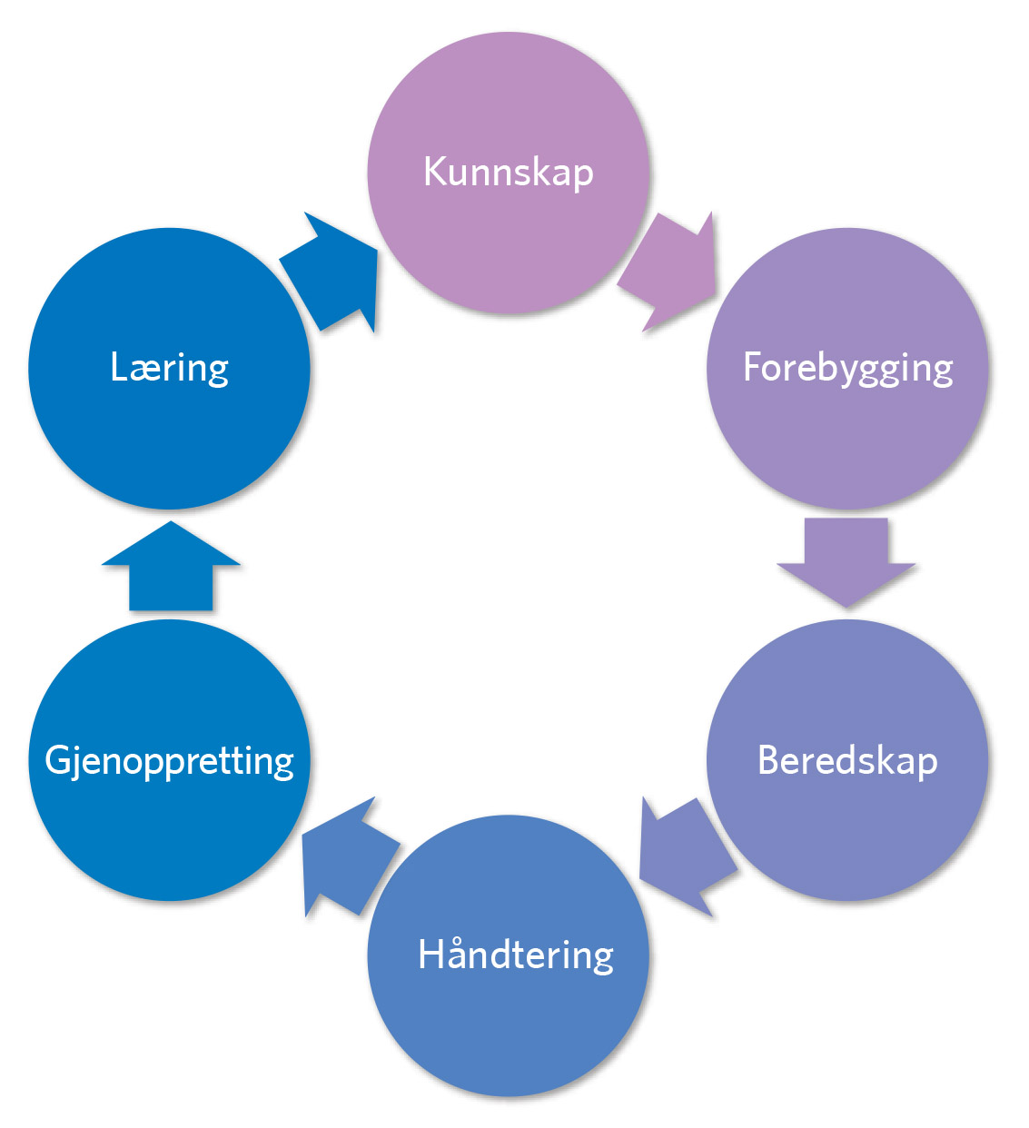
Figur 1.1

Slide 3
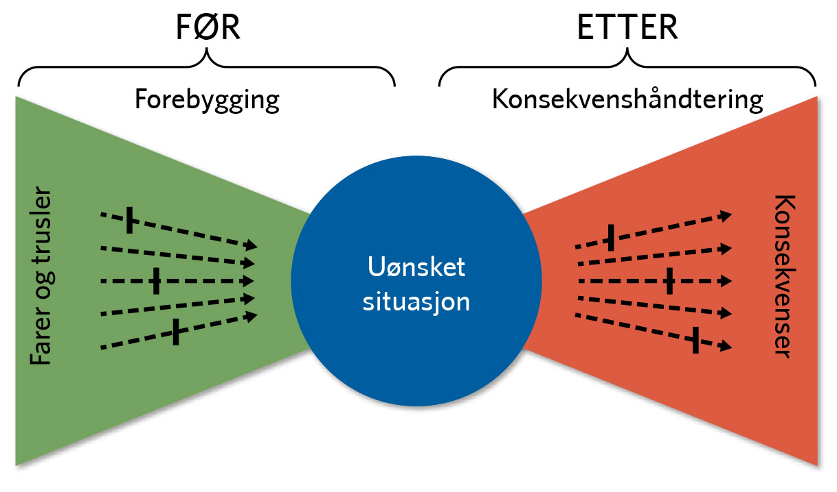
Figur 1.2

Slide 4
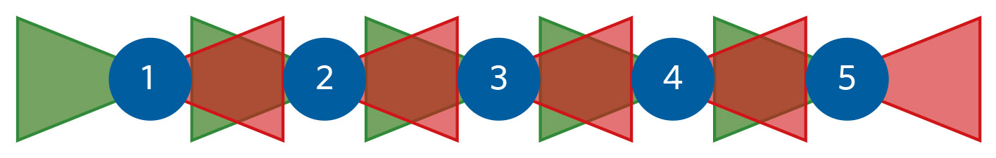
Figur 1.3

Slide 5
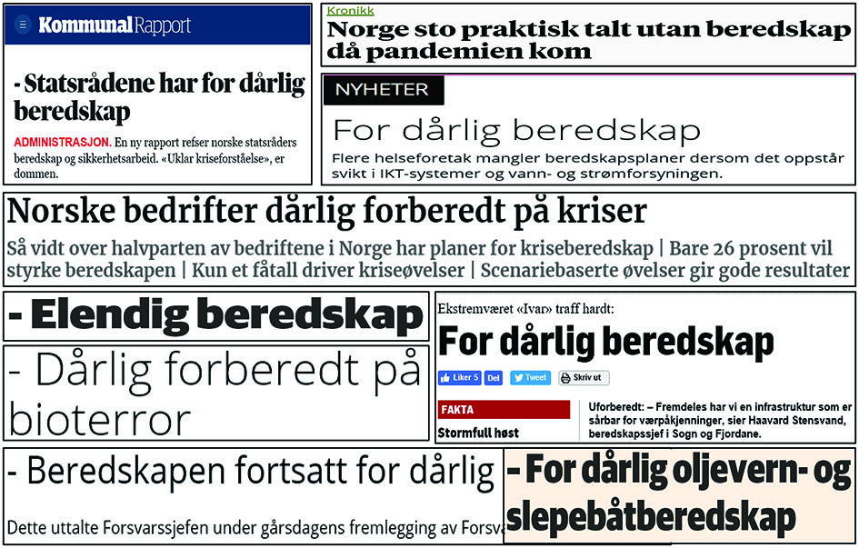
Figur 1.4

Slide 6
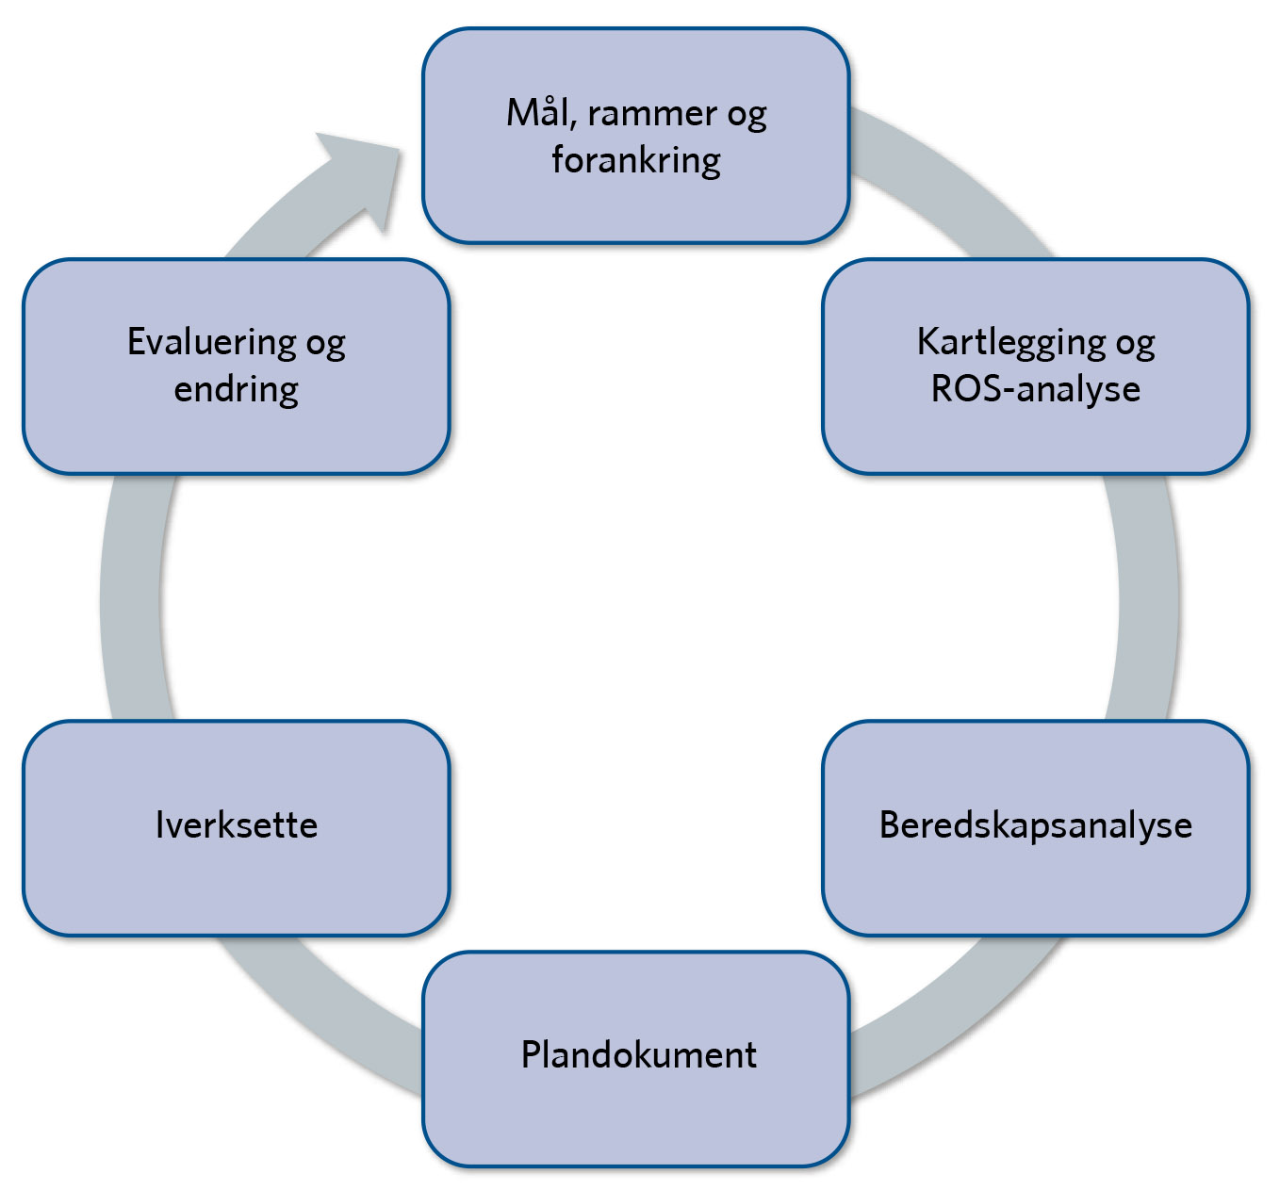
Figur 1.5

Slide 7
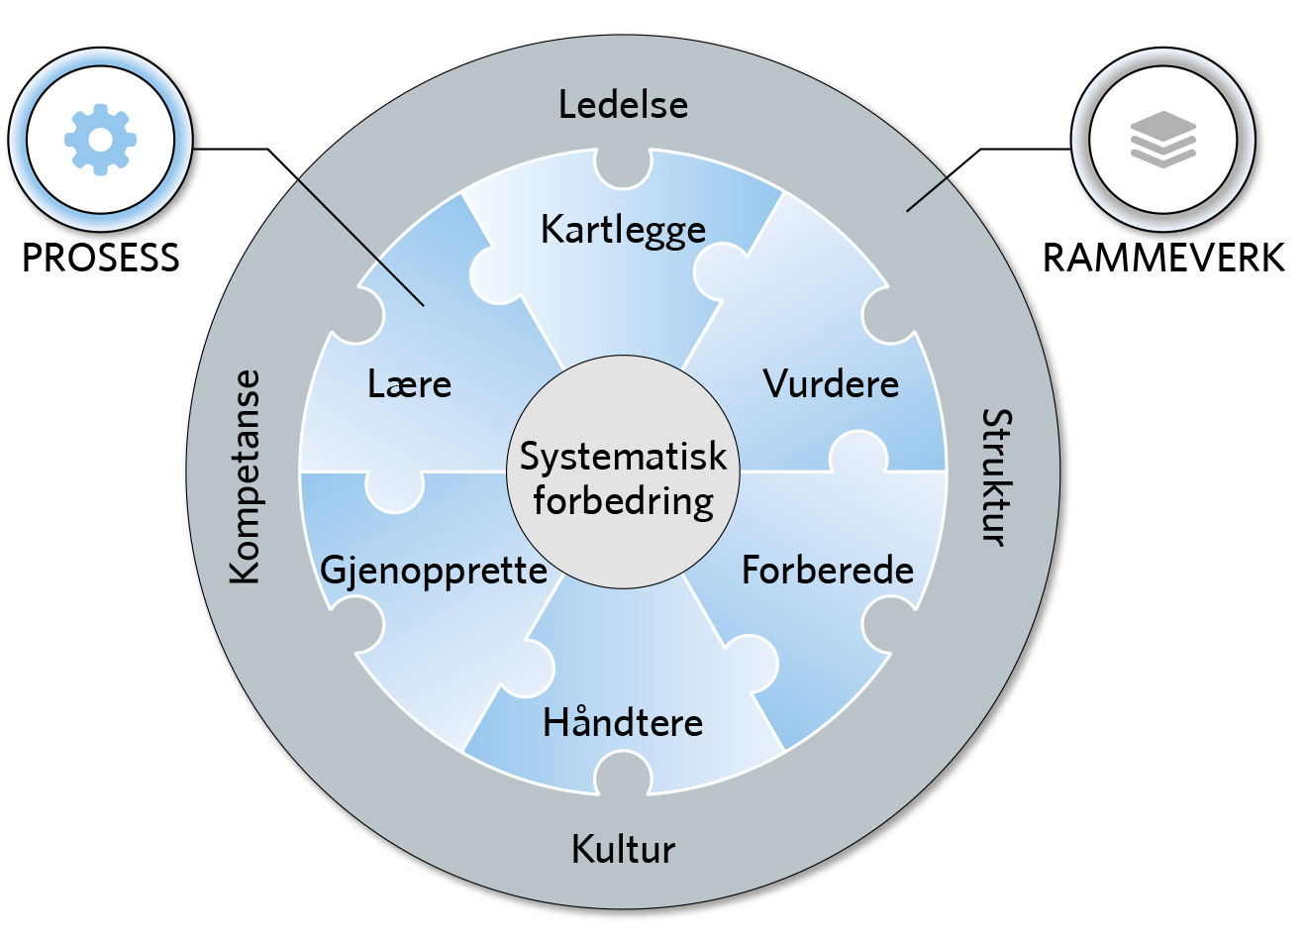
Figur 2.1

Slide 8
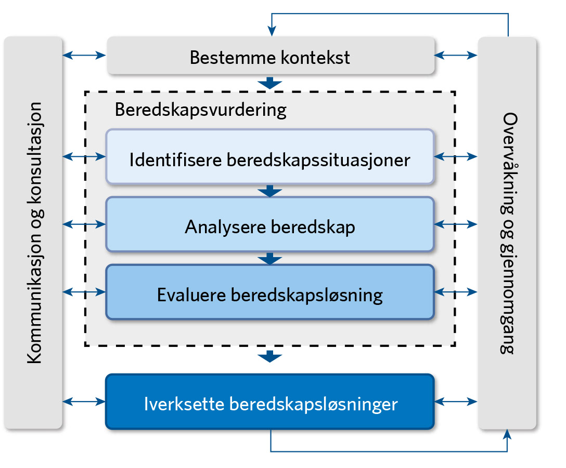
Figur 3.1

Slide 9
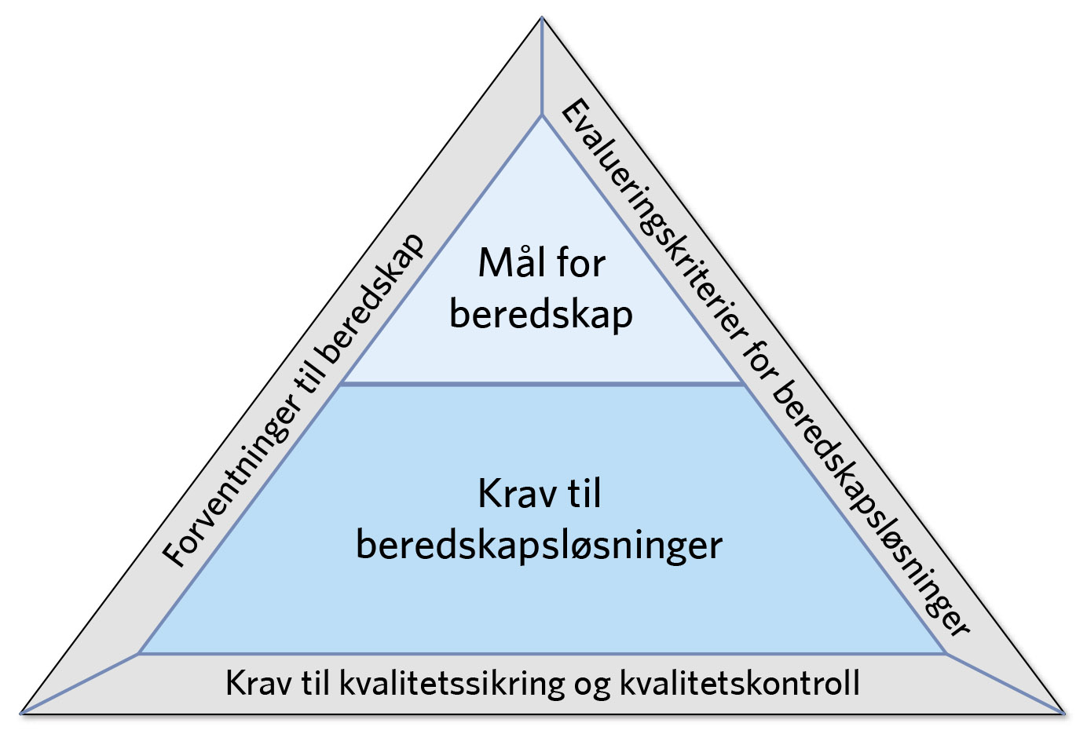
Figur 3.2

Slide 10

Figur 4.1

Slide 11
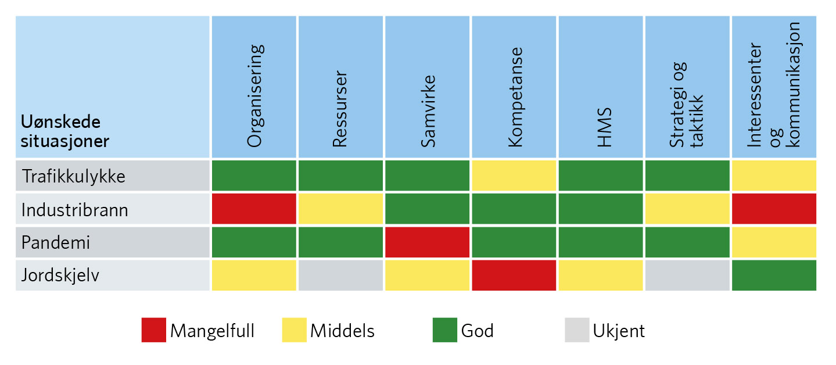
Figur 4.2

Slide 12
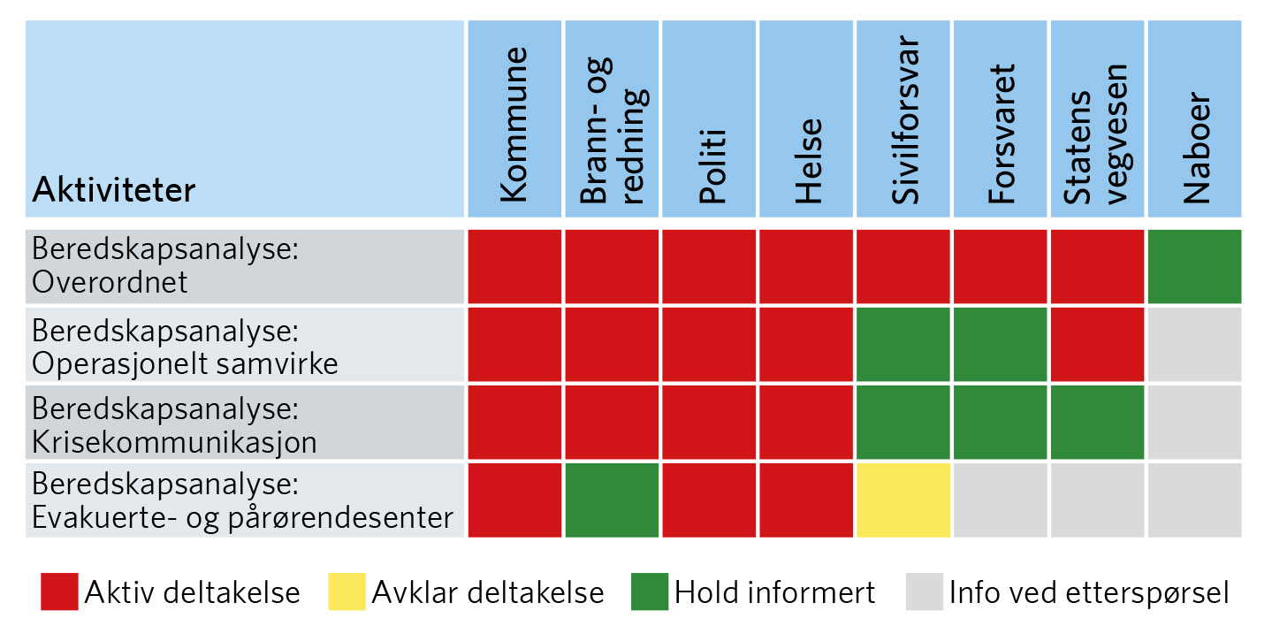
Figur 4.3

Slide 13
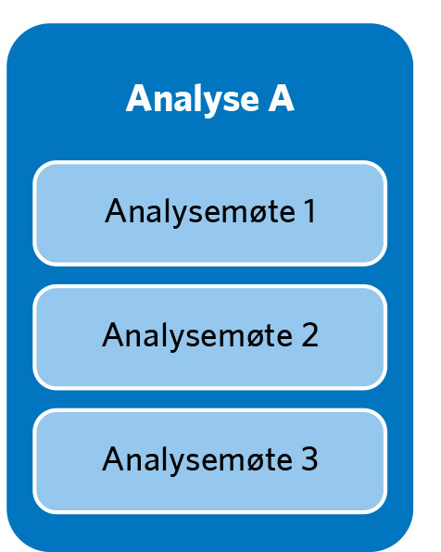
Figur 4.4

Slide 14
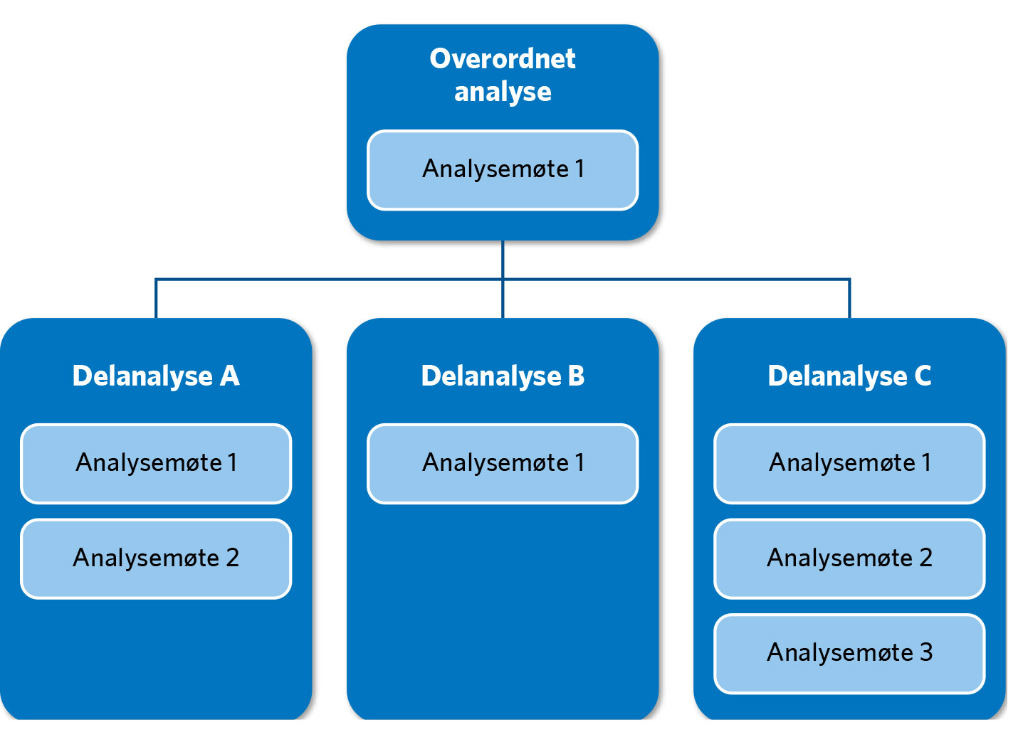
Figur 4.5

Slide 15
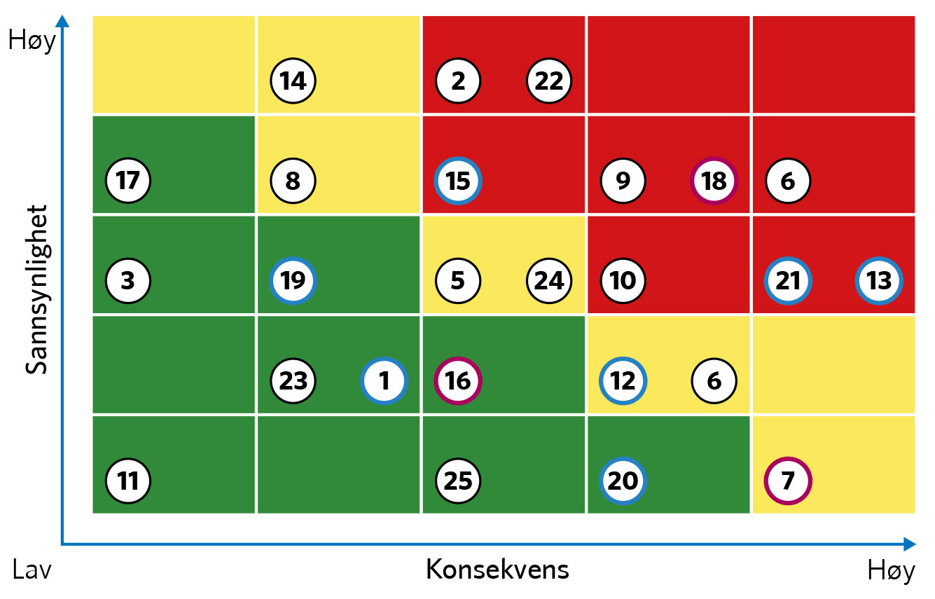
Figur 5.1

Slide 16
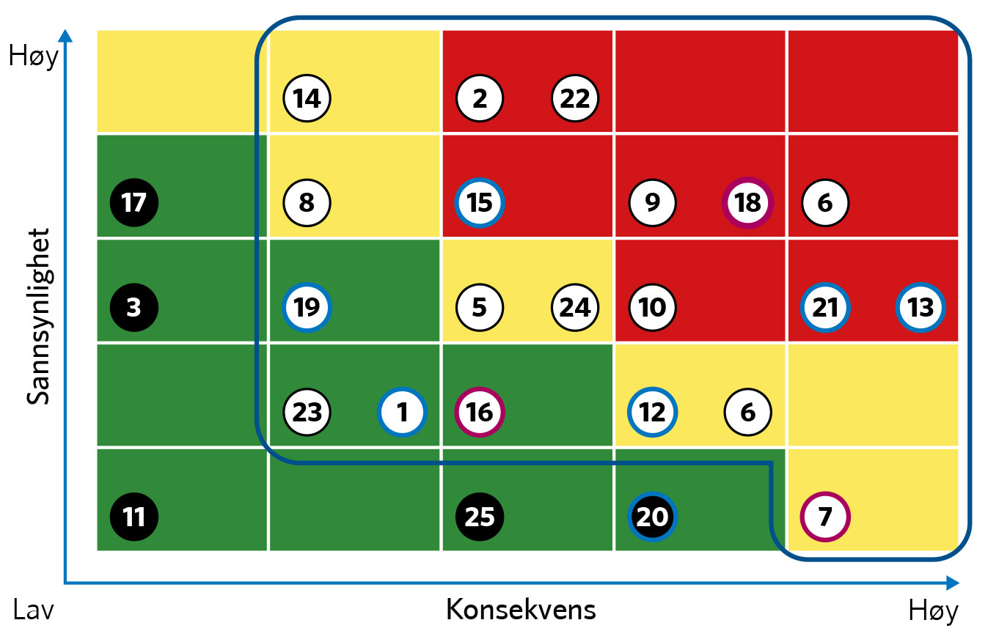
Figur 5.2

Slide 17
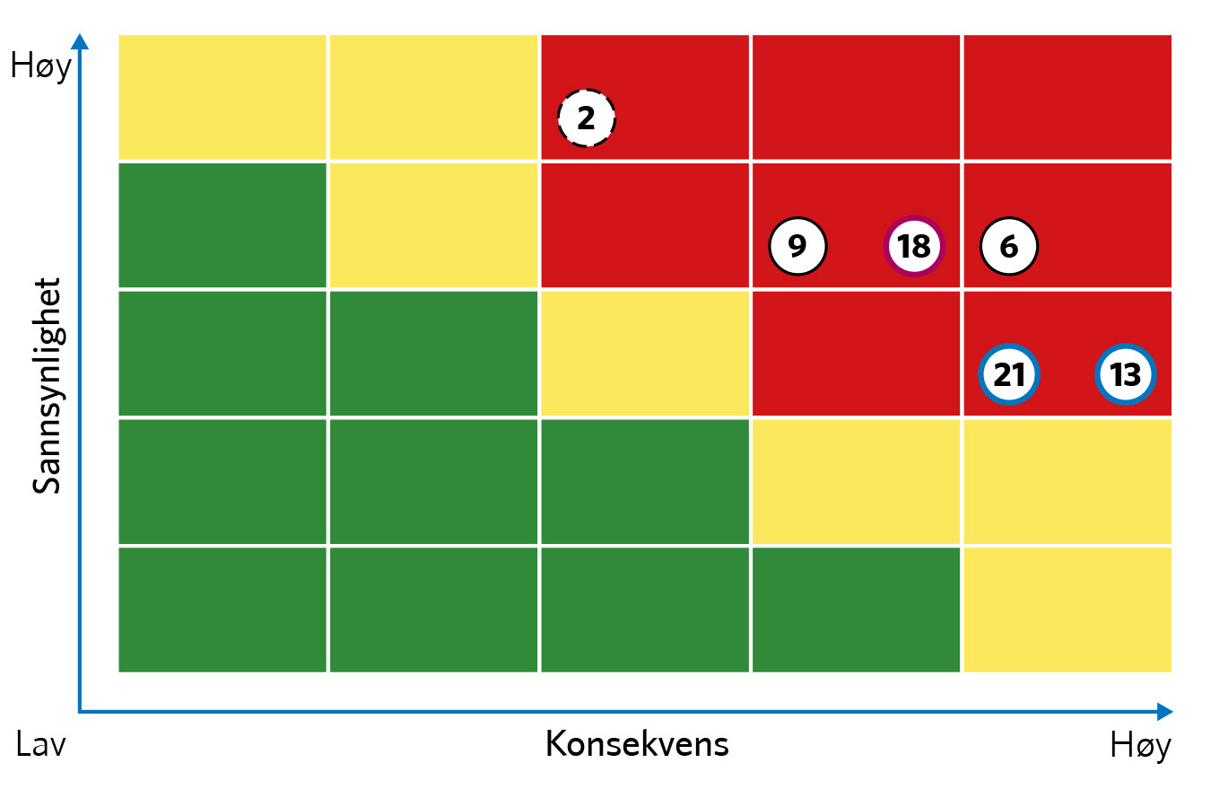
Figur 5.3

Slide 18
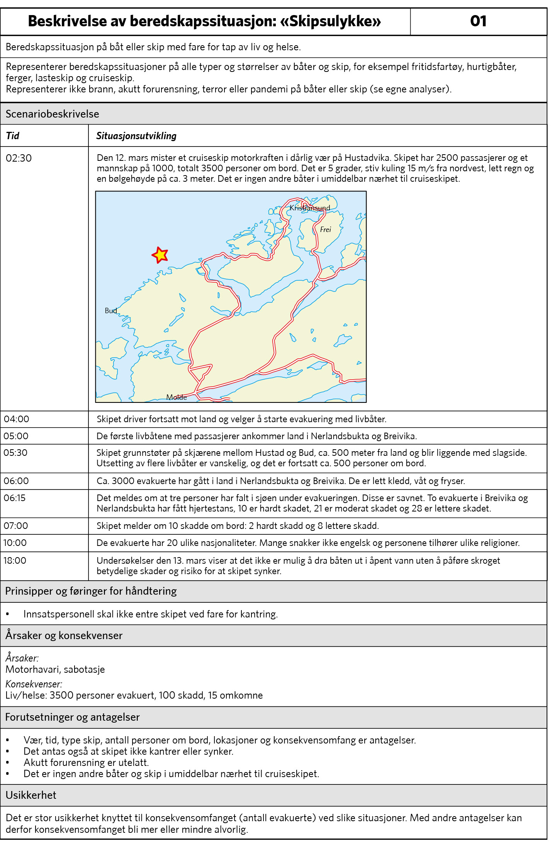
Figur 5.4

Slide 19
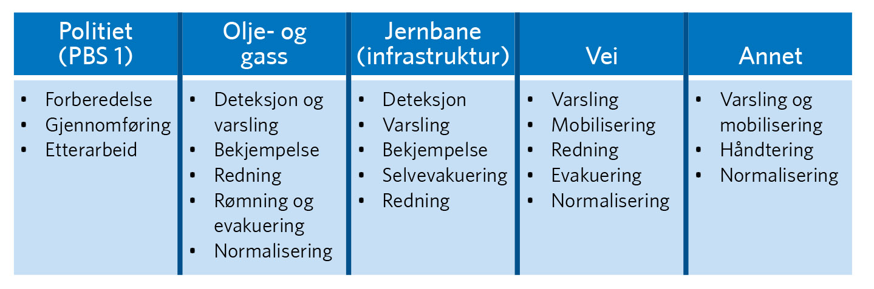
Figur 6.1

Slide 20
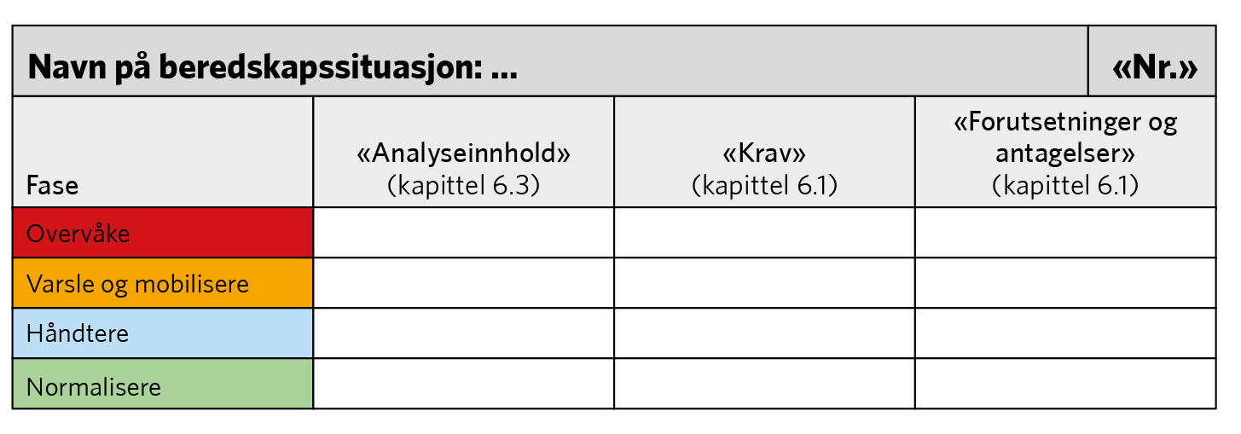
Figur 6.2

Slide 21
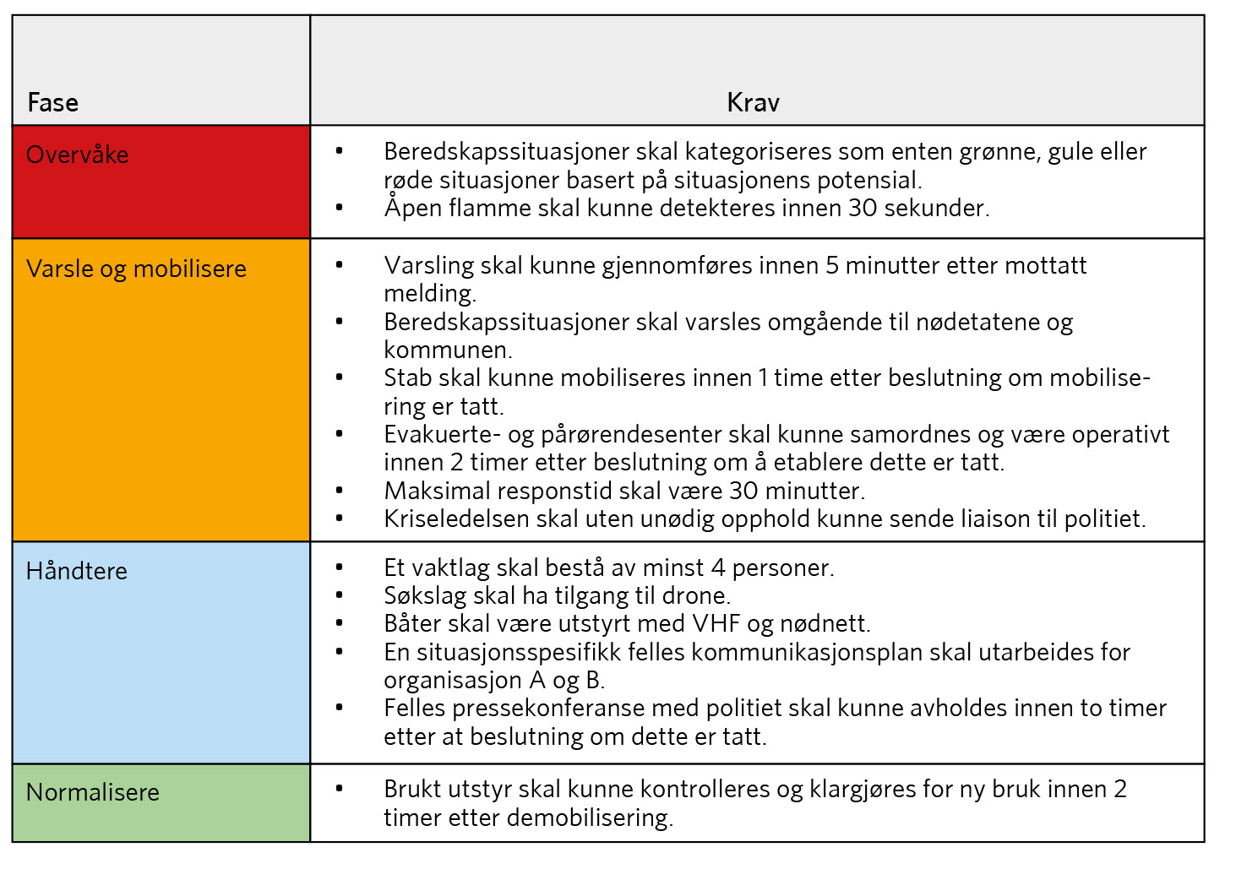
Figur 6.3

Slide 22
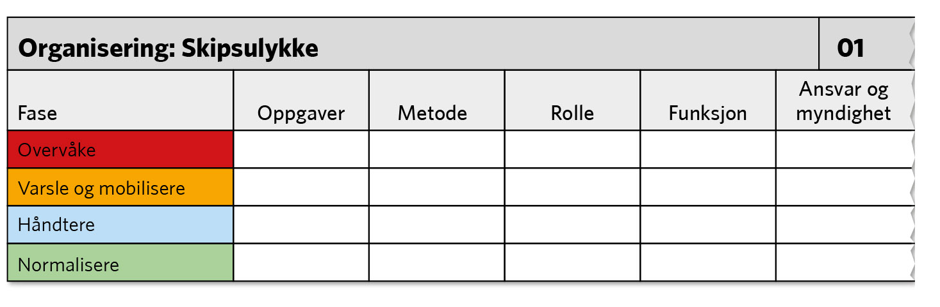
Figur 6.4

Slide 23
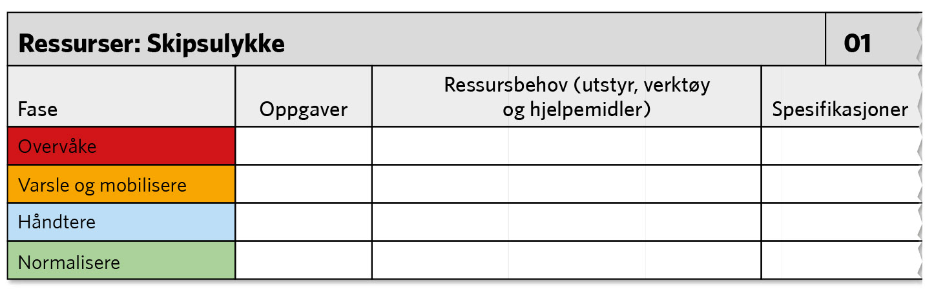
Figur 6.5

Slide 24
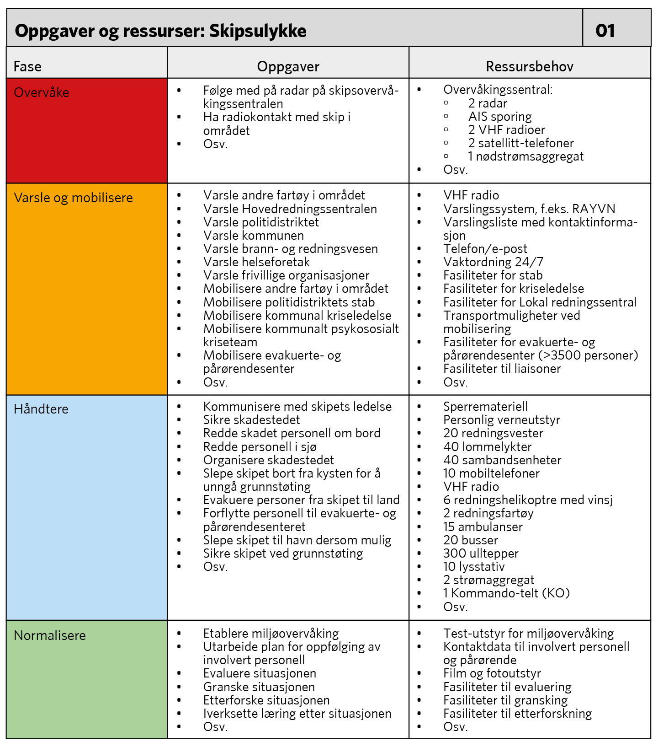
Figur 6.6

Slide 25
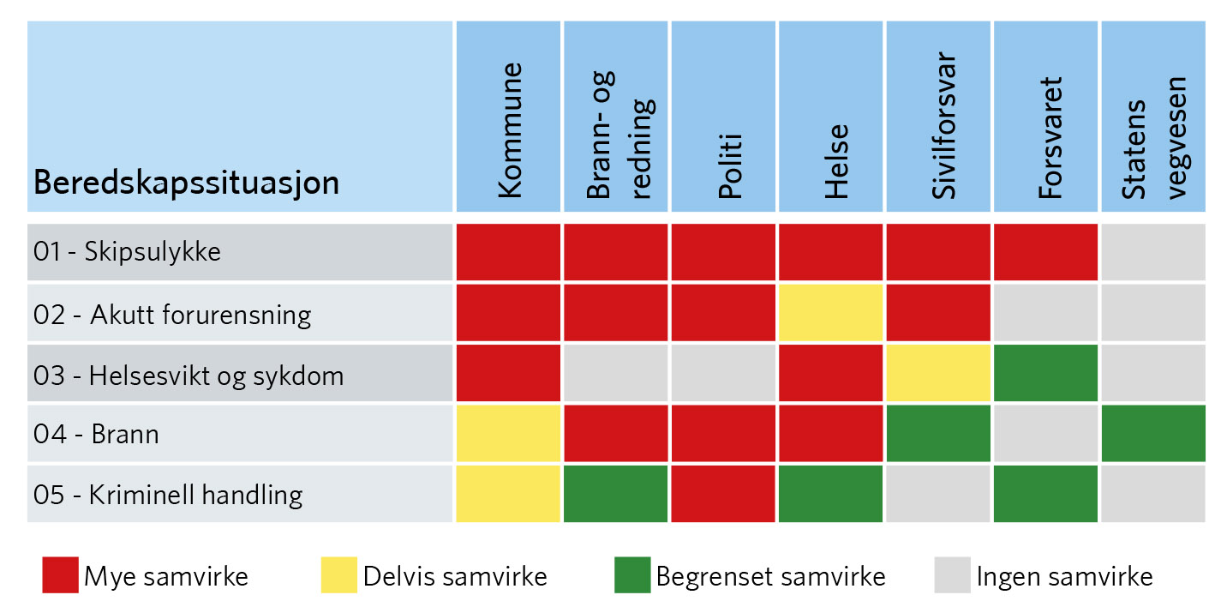
Figur 6.7

Slide 26
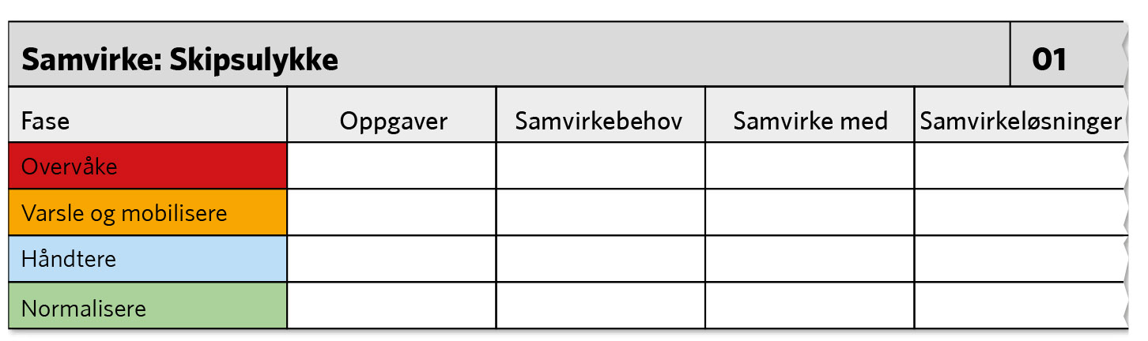
Figur 6.8

Slide 27
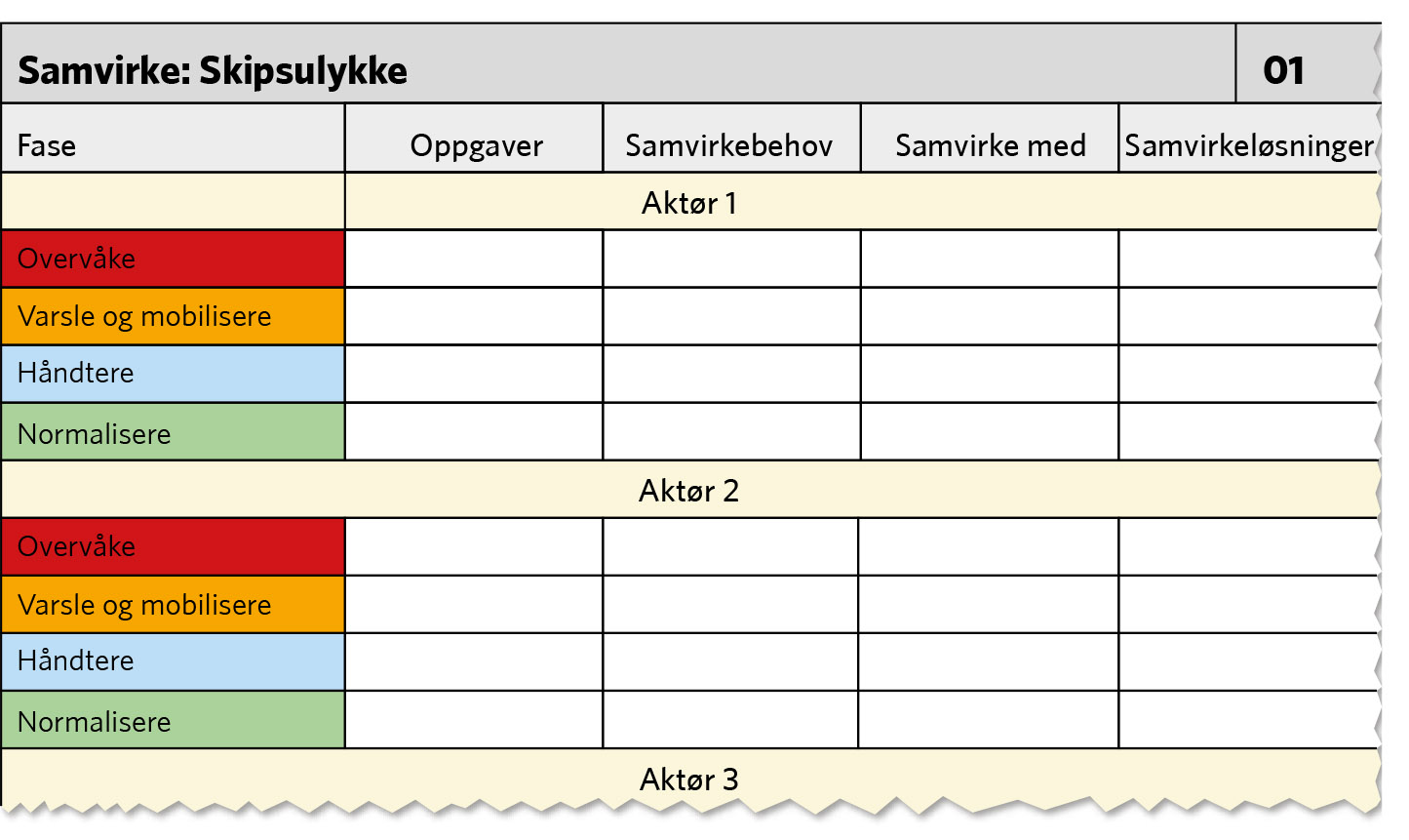
Figur 6.9

Slide 28
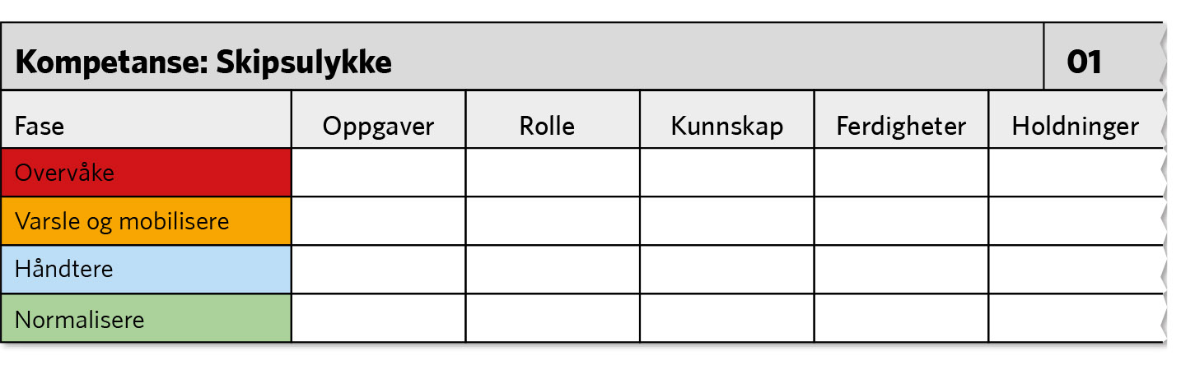
Figur 6.10

Slide 29
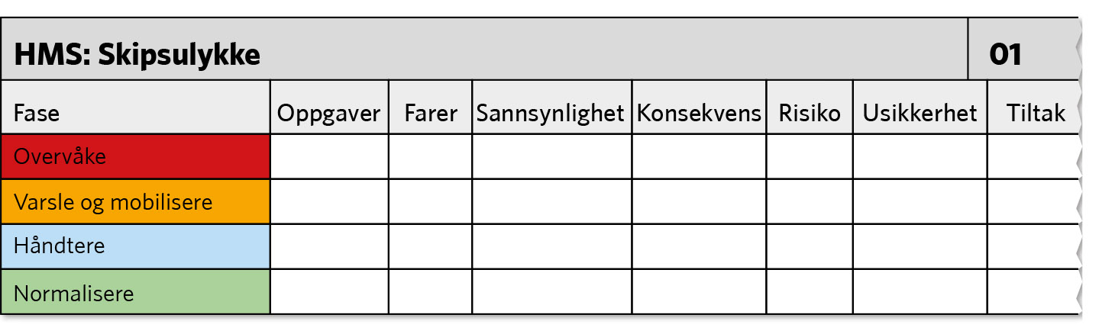
Figur 6.11

Slide 30
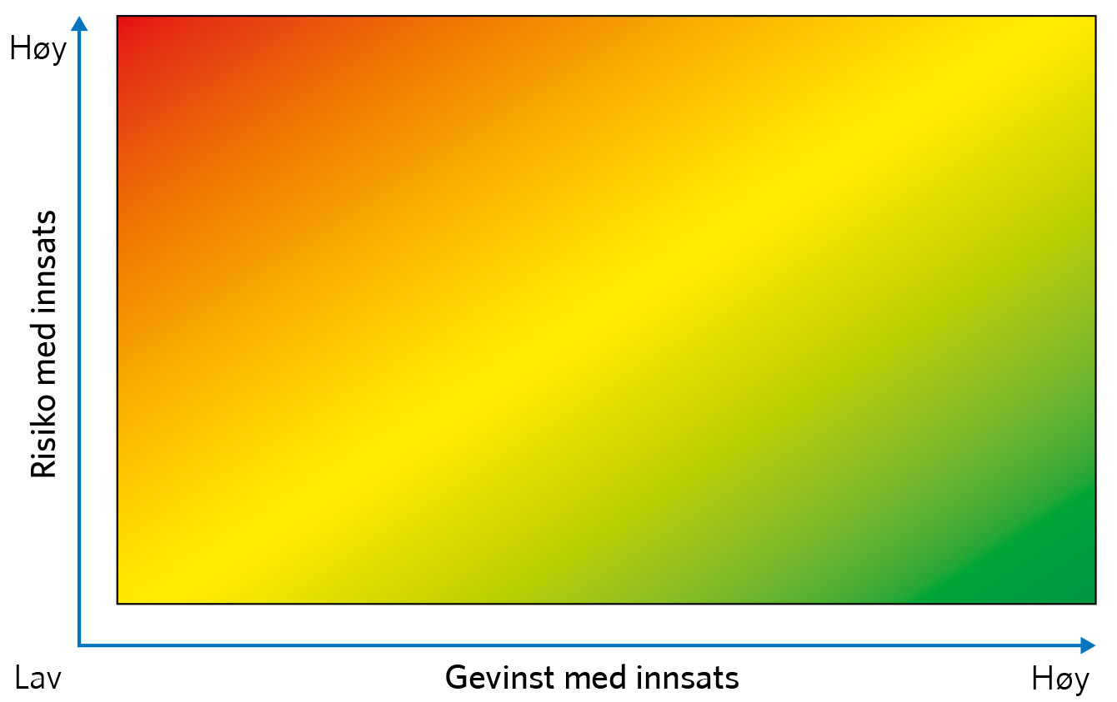
Figur 6.12

Slide 31
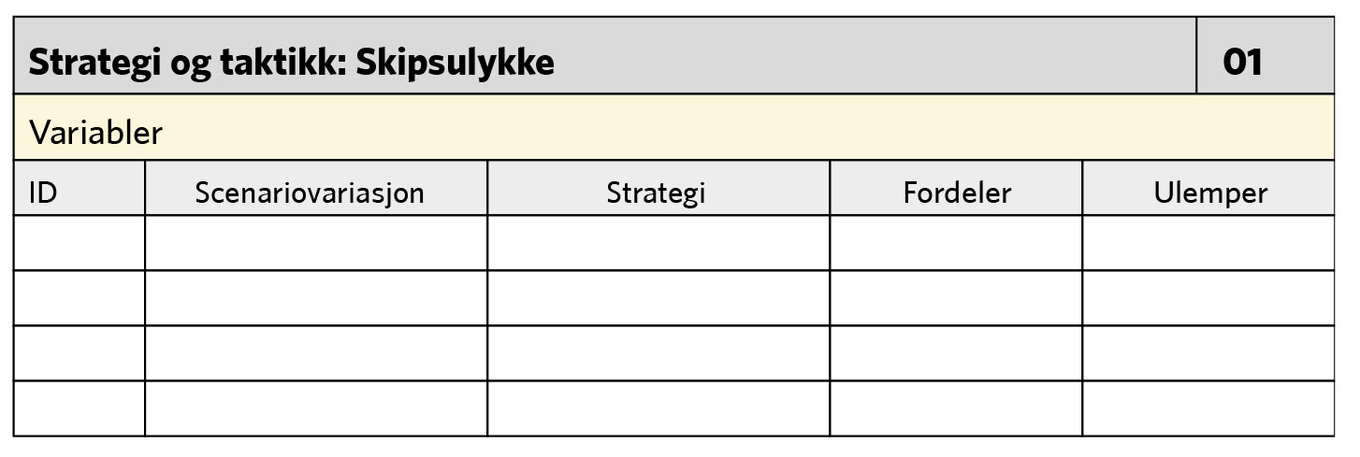
Figur 6.13

Slide 32
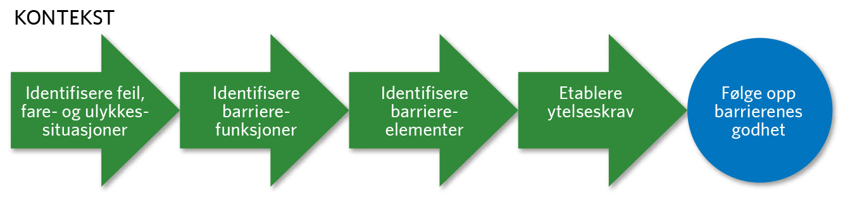
Figur 6.14

Slide 33
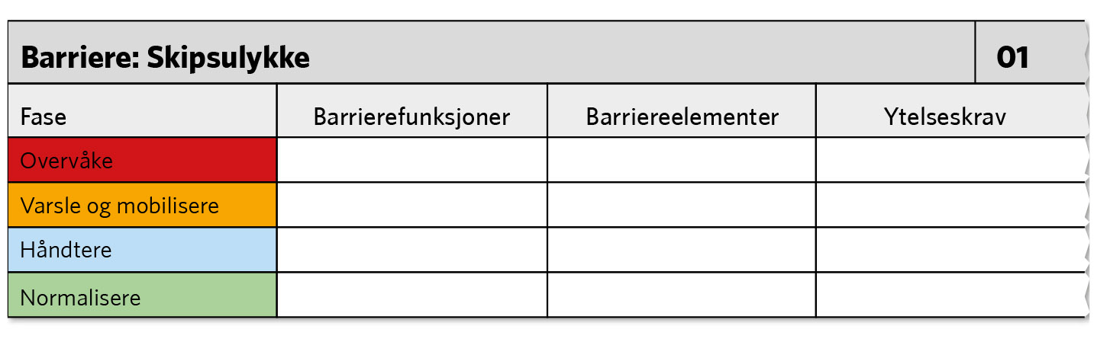
Figur 6.15

Slide 34
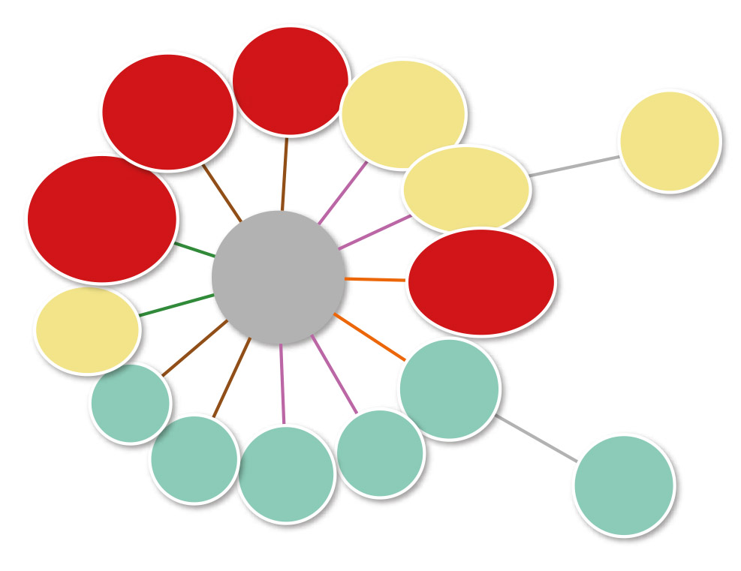
Figur 6.16

Slide 35
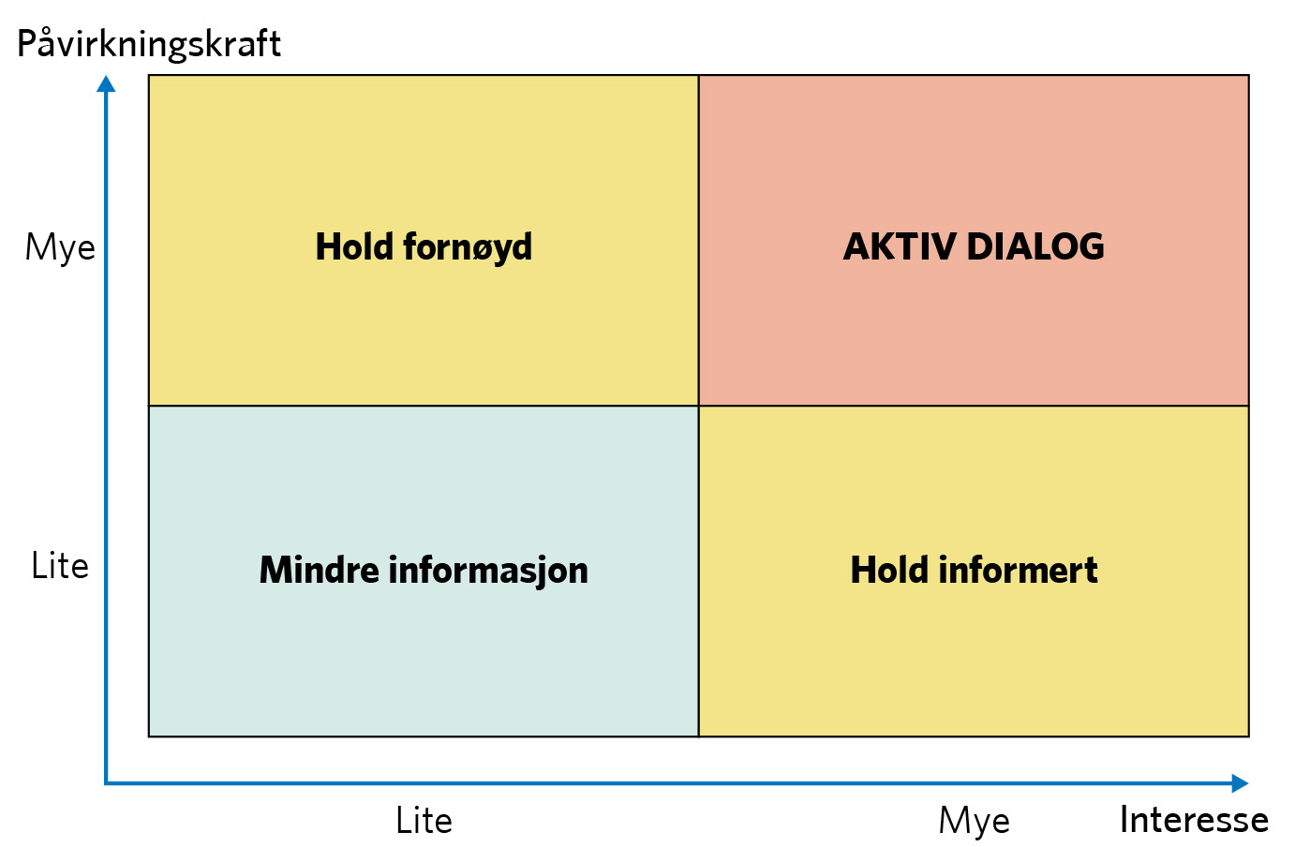
Figur 6.17

Slide 36
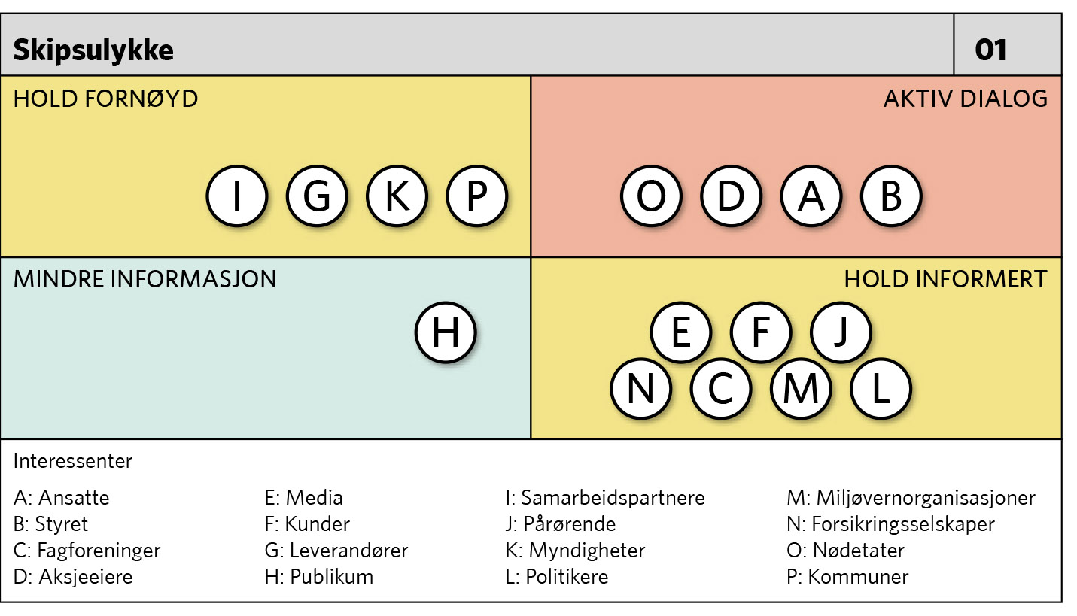
Figur 6.18

Slide 37
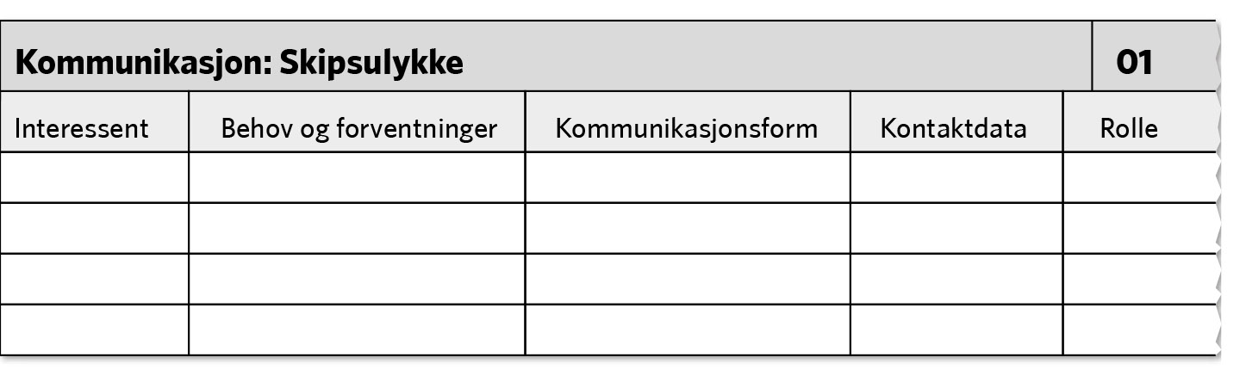
Figur 6.19

Slide 38
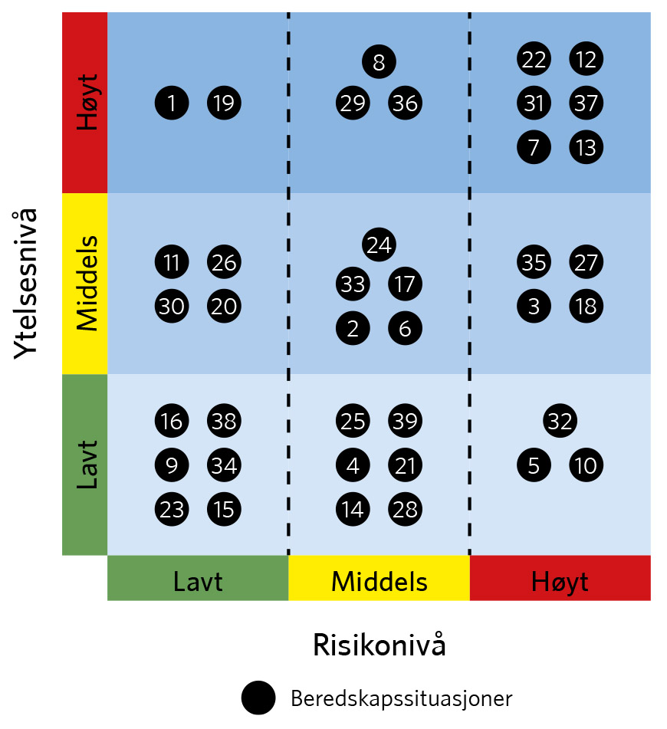
Figur 7.1

Slide 39
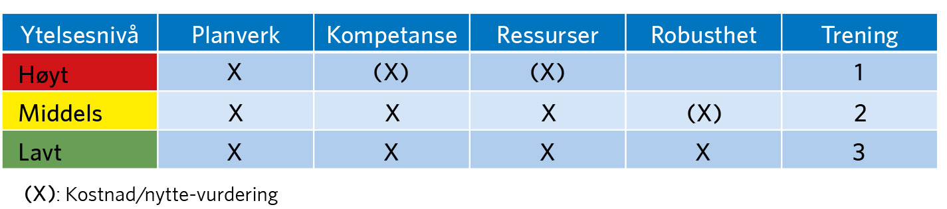
Figur 7.2

Slide 40
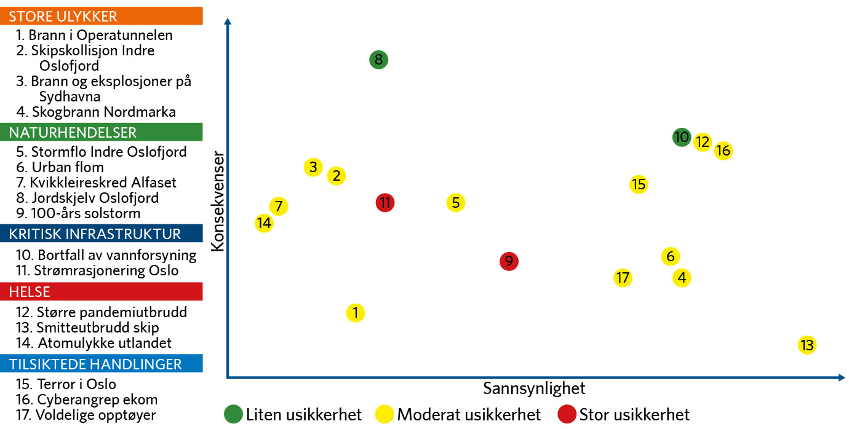
Figur 7.3

Slide 41
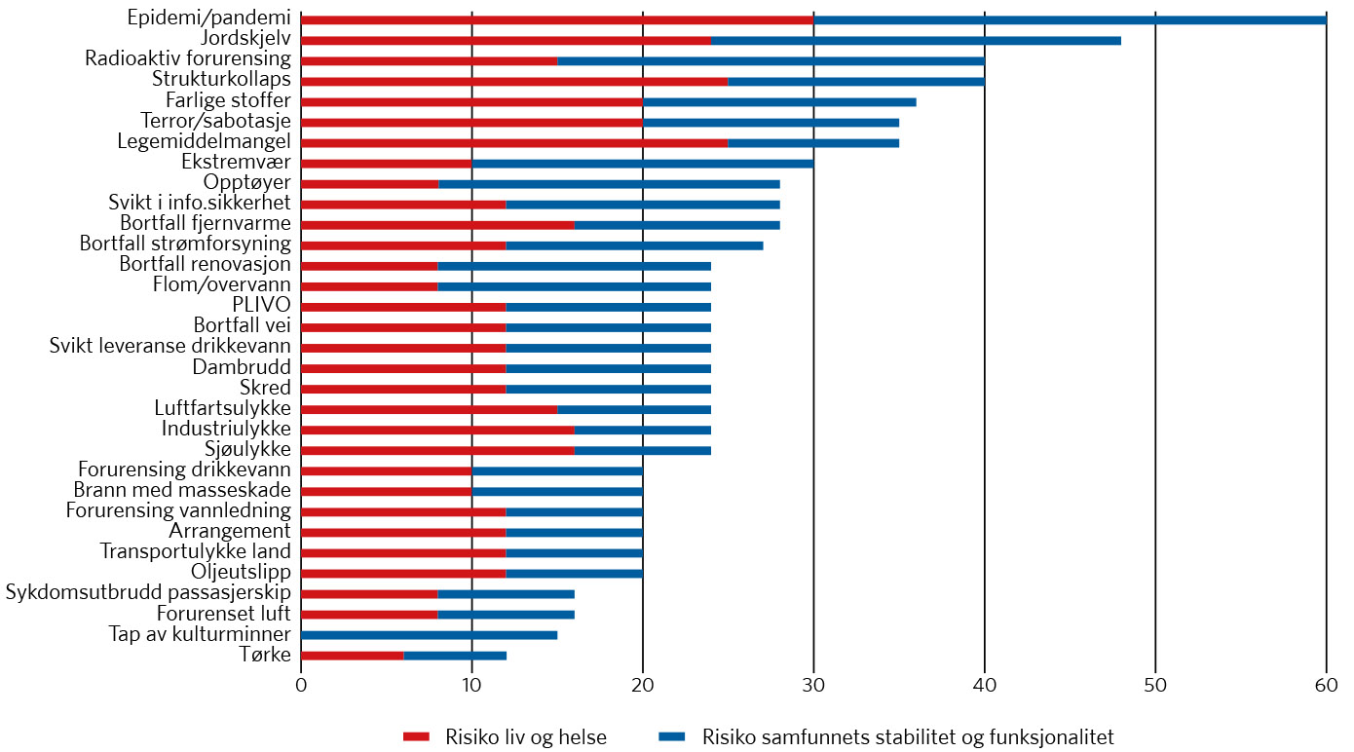
Figur 7.4

Slide 42
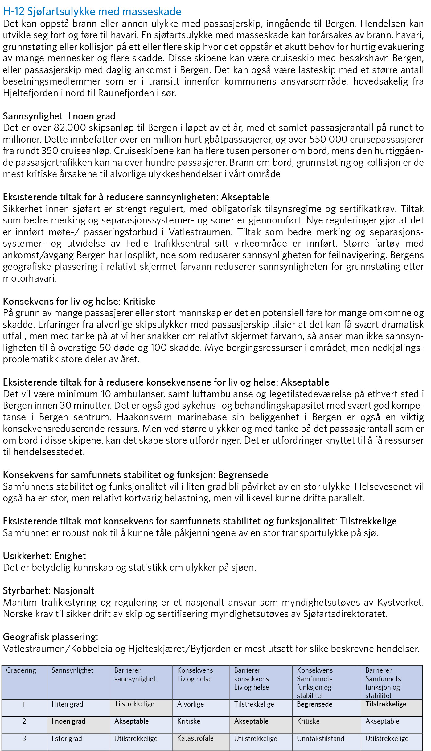
Figur 7.5

Slide 43
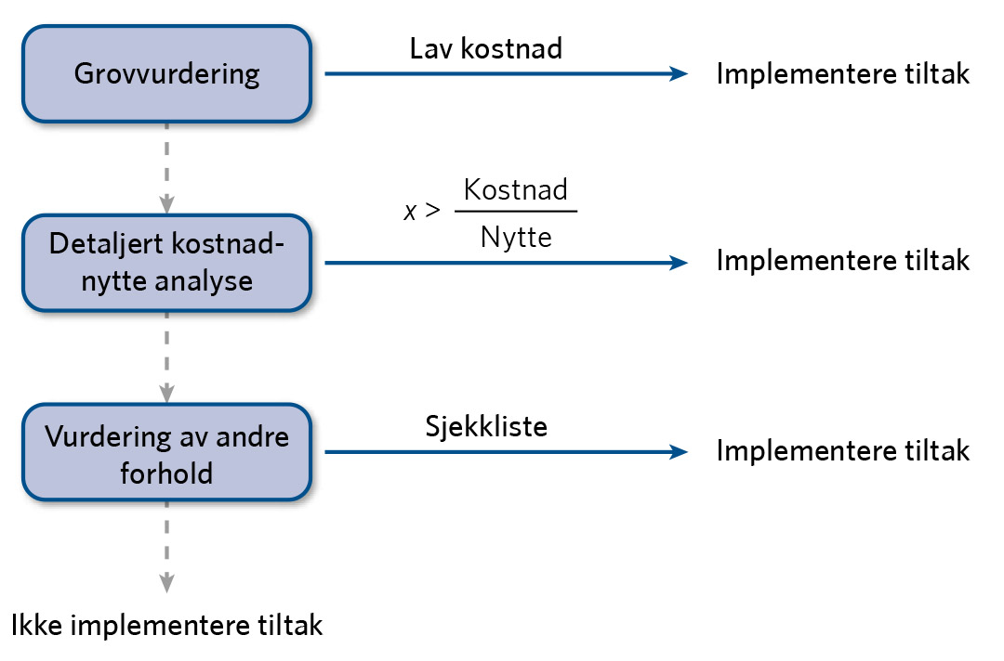
Figur 7.6

Slide 44
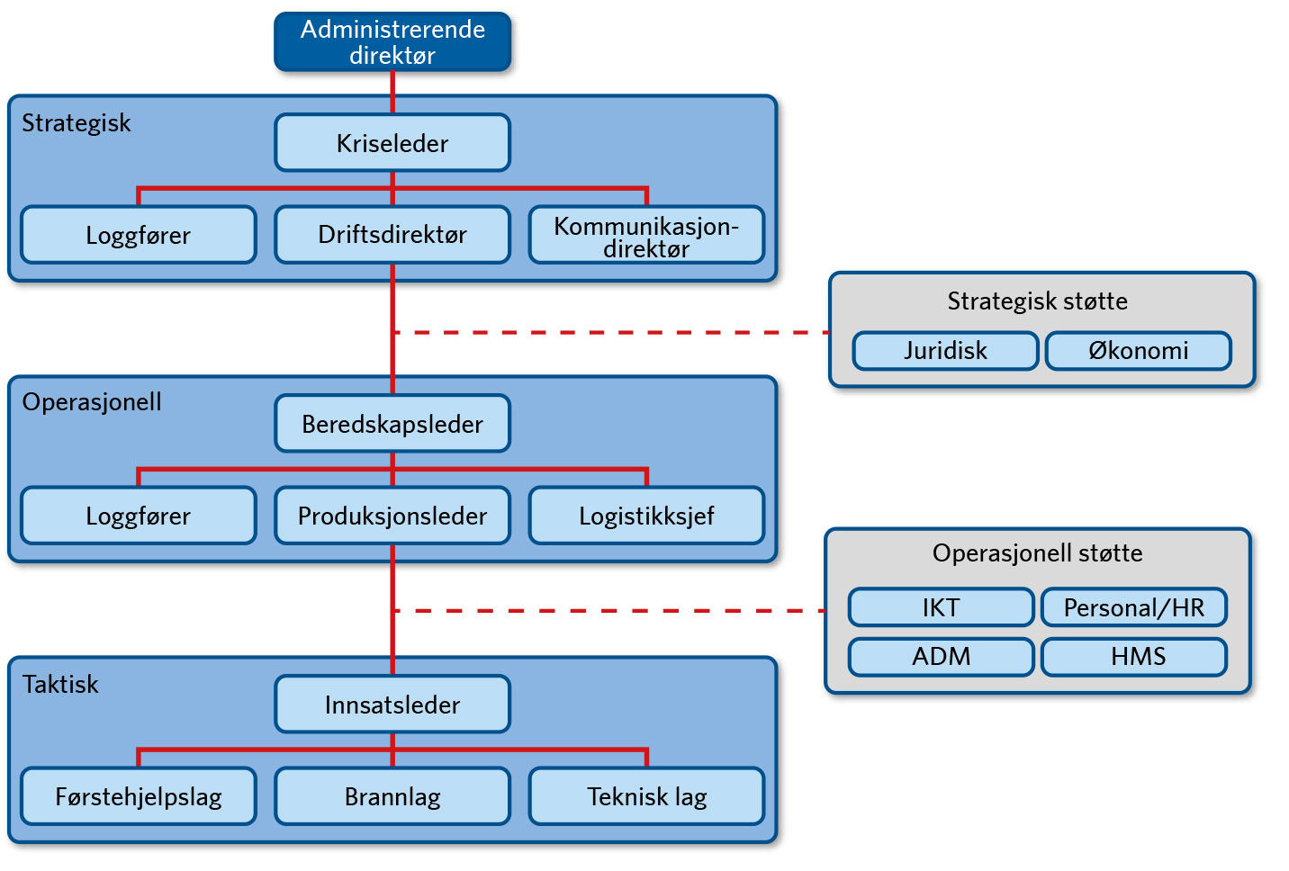
Figur 8.1

Slide 45
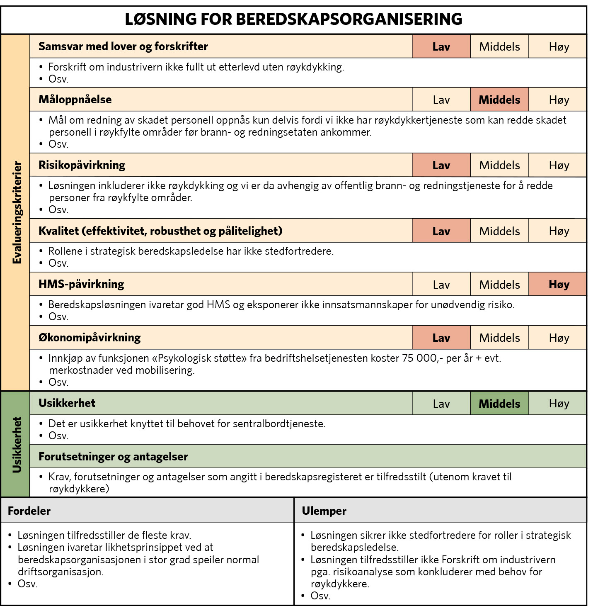
Figur 8.2

Slide 46
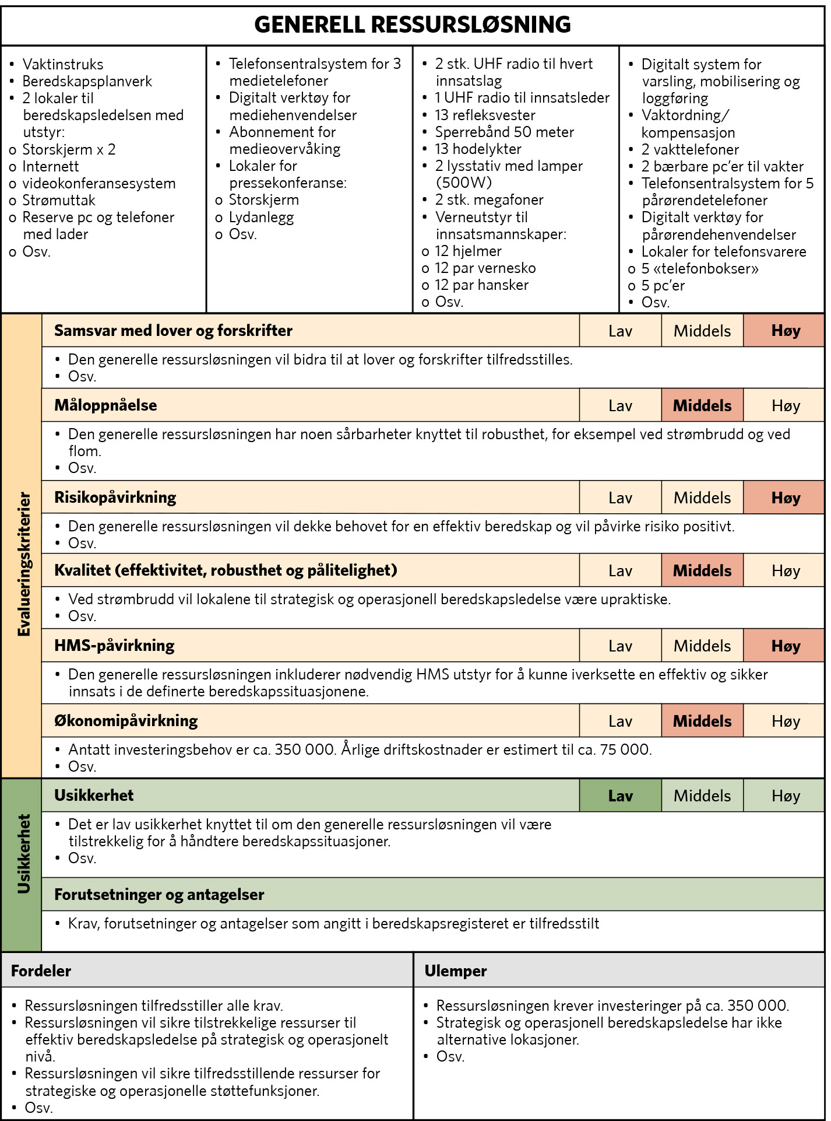
Figur 8.3

Slide 47
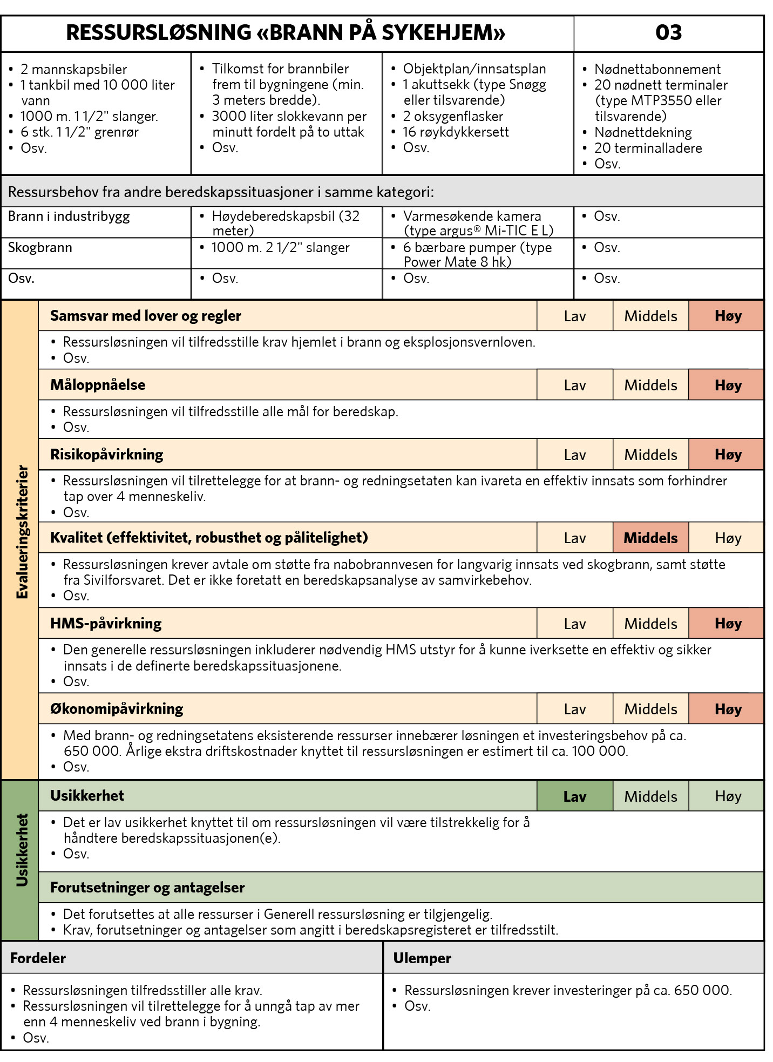
Figur 8.4

Slide 48
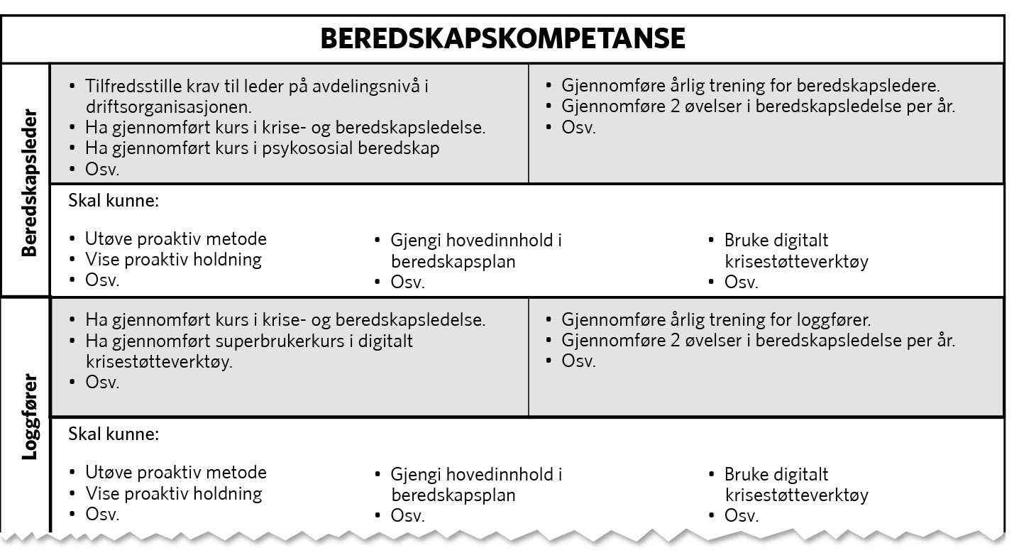
Figur 8.5

Slide 49
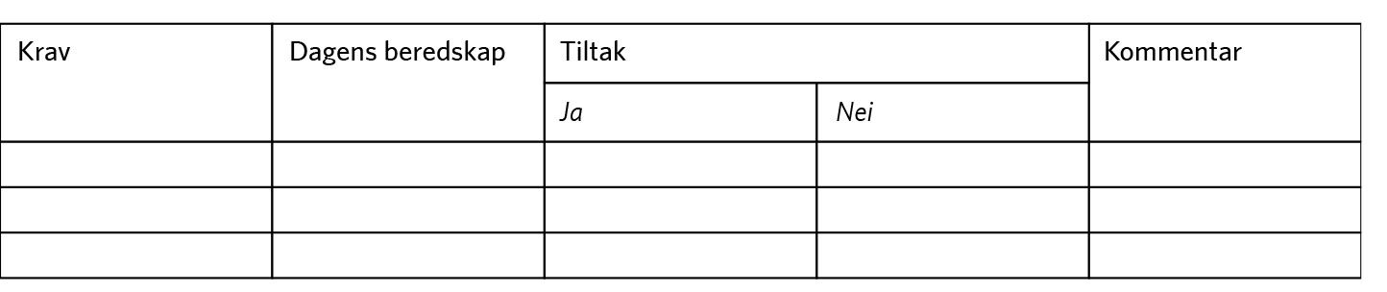
Figur 8.6

Slide 50
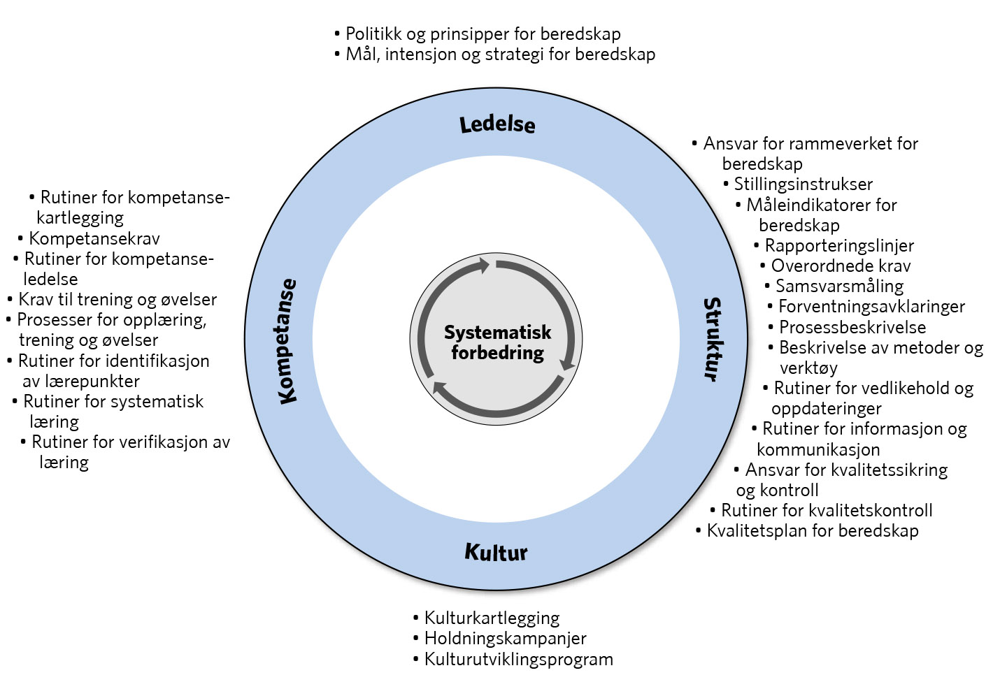
Figur 9.1

Slide 51
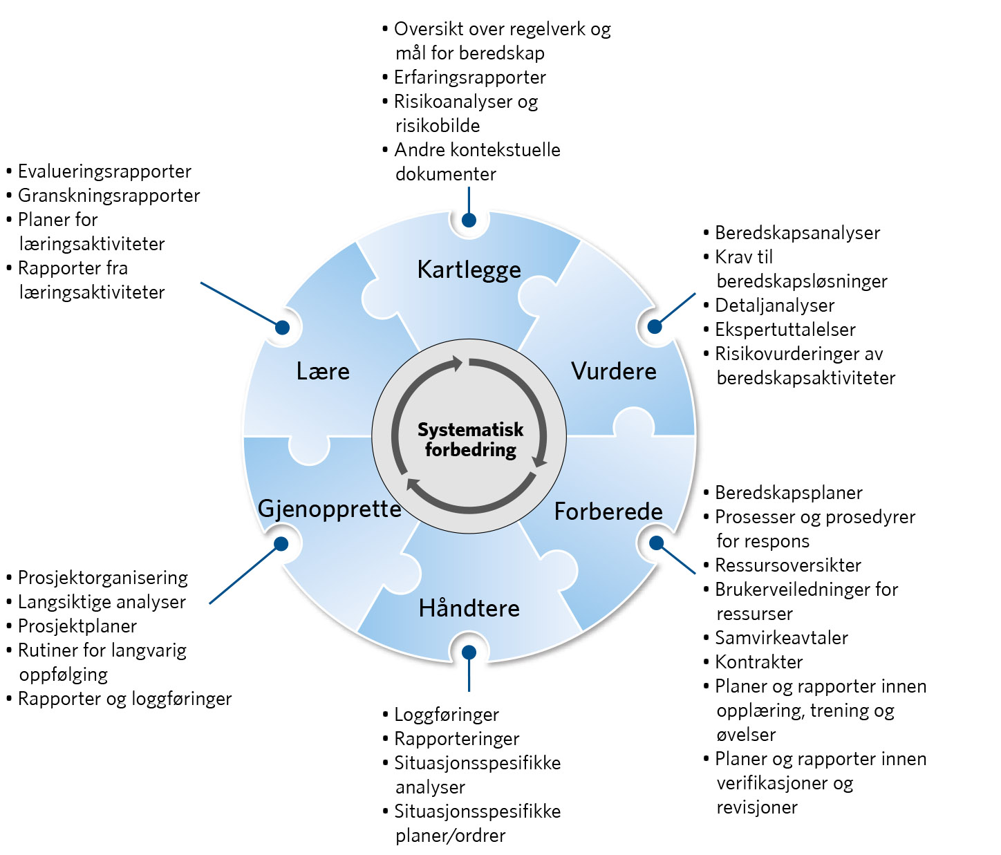
Figur 9.2

Slide 52
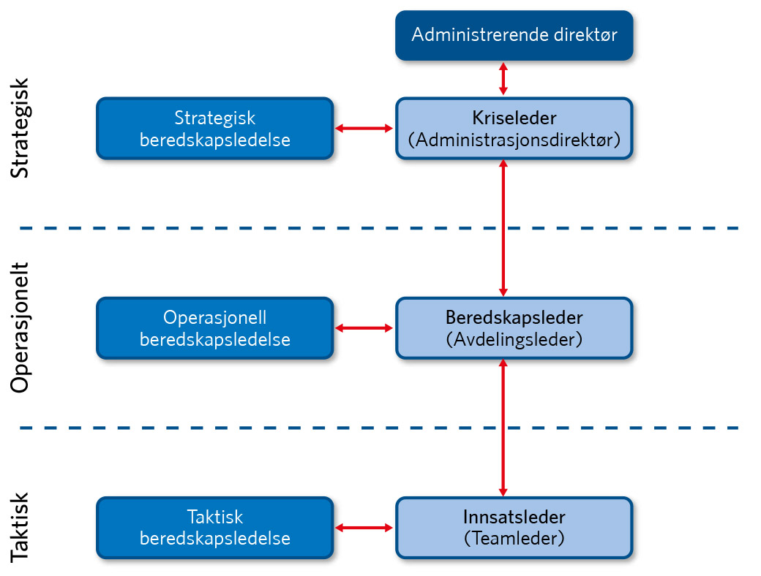
Figur 9.3

Slide 53

Figur 9.4

Slide 54

Figur 9.5

Slide 55

Figur 9.6

Slide 56

Figur 9.7

Slide 57

Figur 9.8

Slide 58

Figur 9.9

Slide 59

Figur 9.10

Slide 60

Figur 9.11

Slide 61

Figur 9.12

Slide 62

Figur 9.13

Slide 63

Figur 10.1

Slide 64

Figur 10.2

Slide 65

Figur Ia

Slide 66

Figur Ib

Slide 67

Figur Ic

Slide 68

Figur IIa

Slide 69

Figur IIb

Slide 70

Figur IIc

Slide 71

Figur III

Slide 72

Figur IV

Slide 73

Figur Va

Slide 74

Figur Vb

Slide 75

Figur Vc

Slide 76

Figur VI

Slide 77

Figur VII

Slide 78

Figur VIII

Slide 79

Figur IX

Slide 80

Figur X

Slide 81

Figur XI

Slide 82

Figur XII

Slide 83

Figur XIII

Slide 84

Figur XIV

